Slide 1
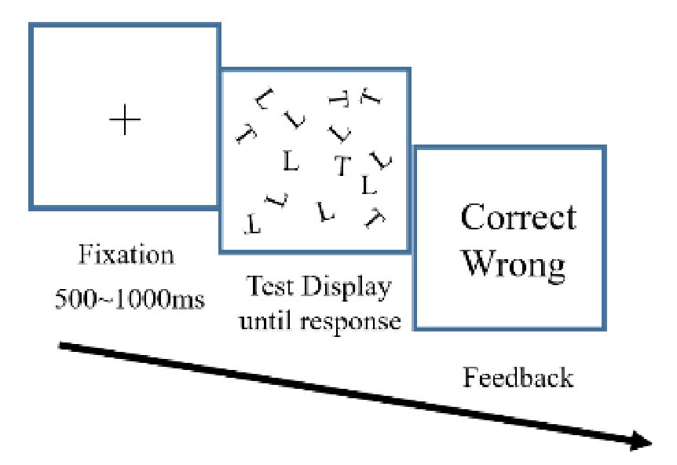

Slide 2
H
L
X
H
L
X

Slide 3
HH
XH
HX
XX

Slide 4
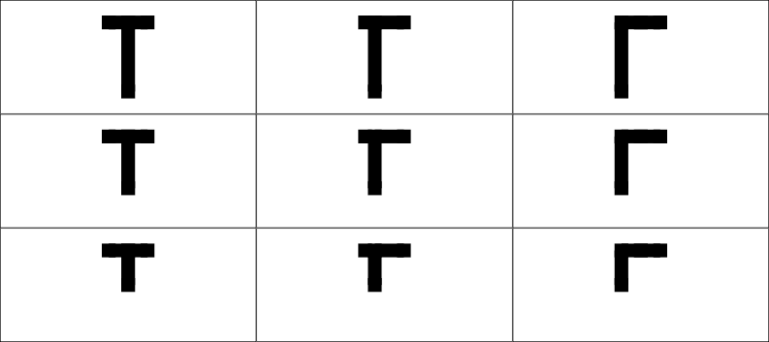

Slide 5
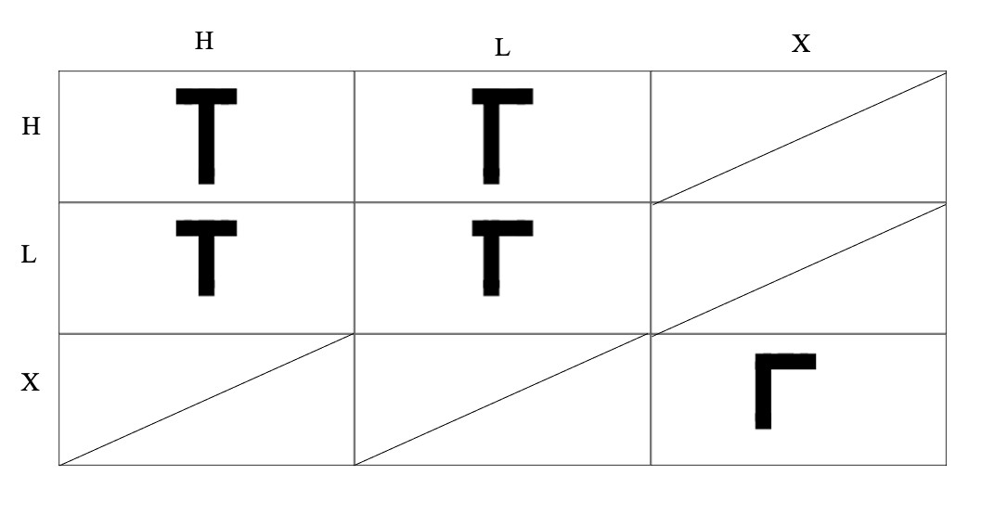

Slide 6
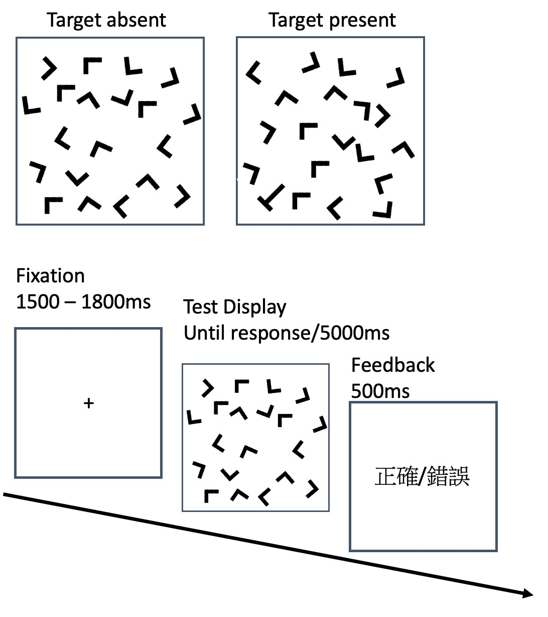

Slide 7
